Slide 1
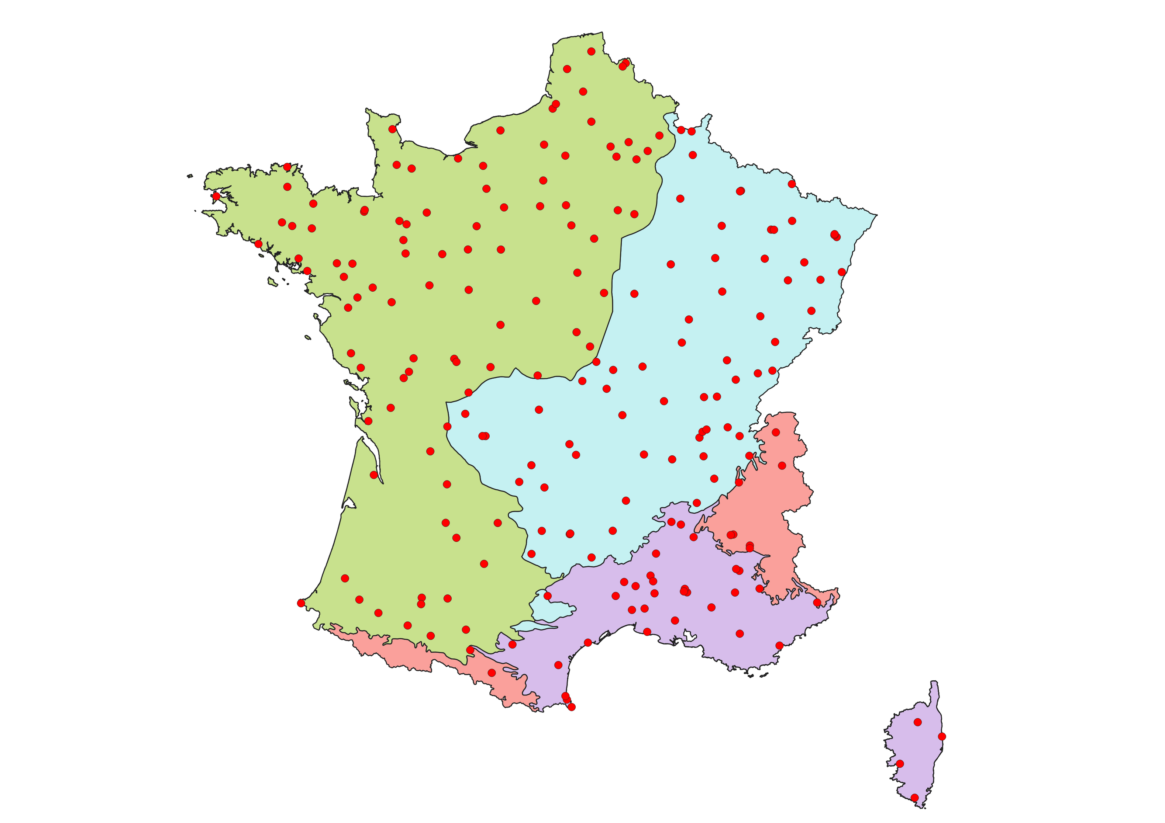







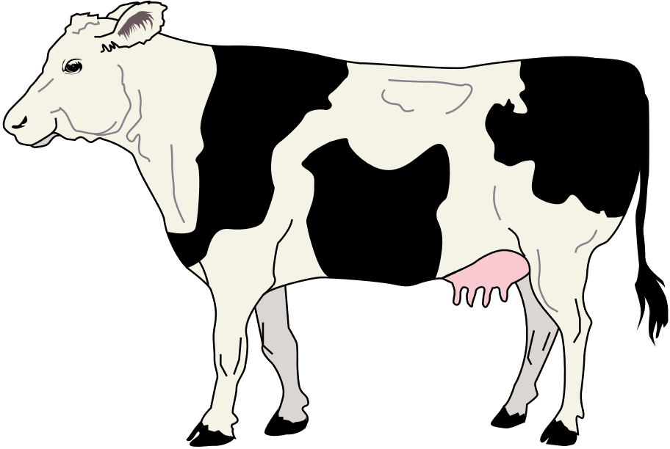
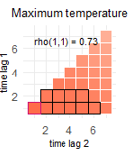
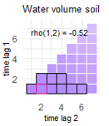
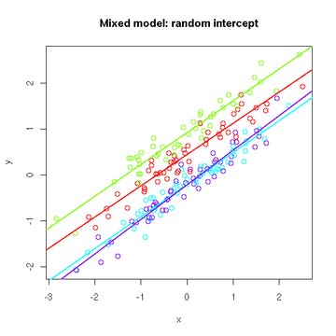

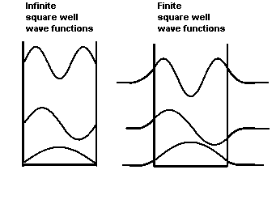
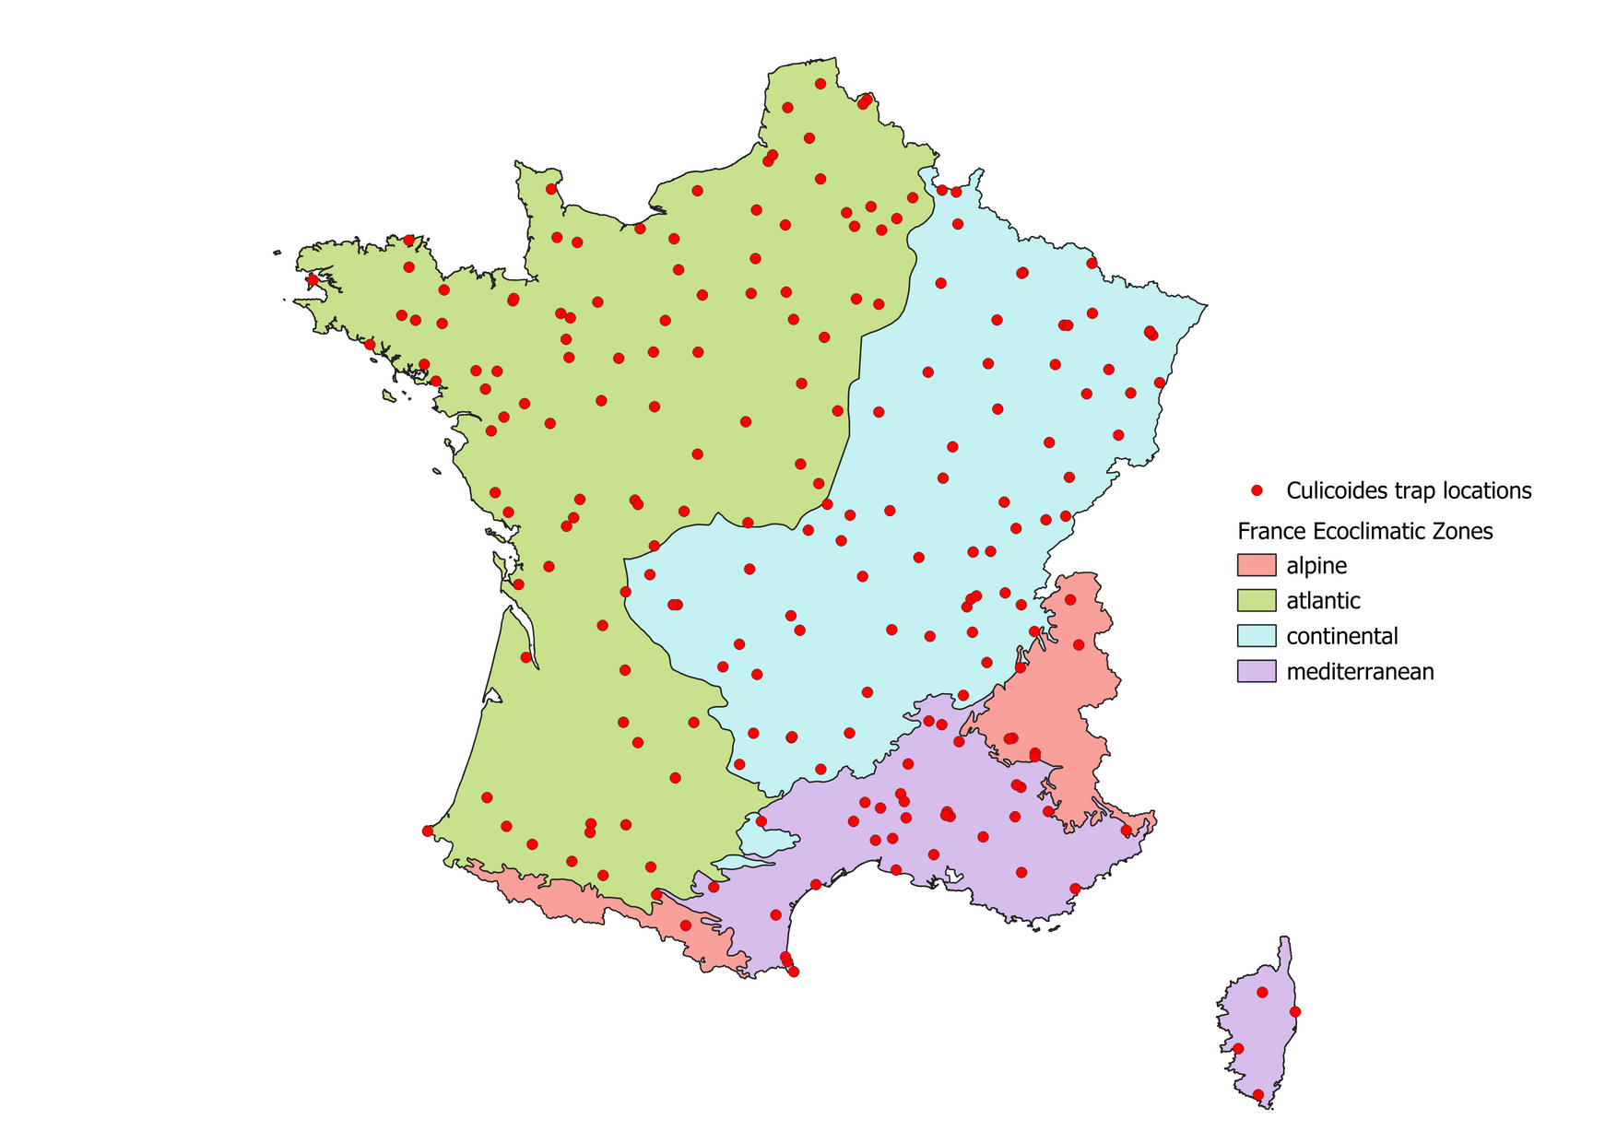

Climatic
variables
Landscape and microclimatic variables
2009-2012 Culicoides trap data
Satellite data
9 x 9 km grid
Daily measurments
Point location data:
Ouverture du bâtiment
Type d’élevage
Force du vent
Variable selection
~200 traps
1-2 traps / department
14895 trapping sessions
Cross-Correlation Maps
General Linear Mixed Model
Presence/absence model
Abundance
model
ML
approaches

Slide 2
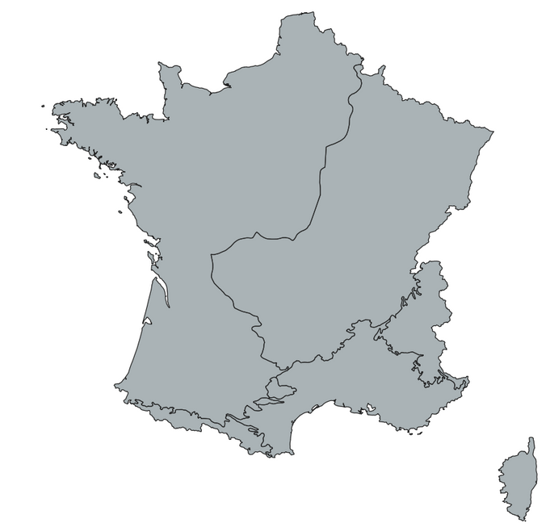


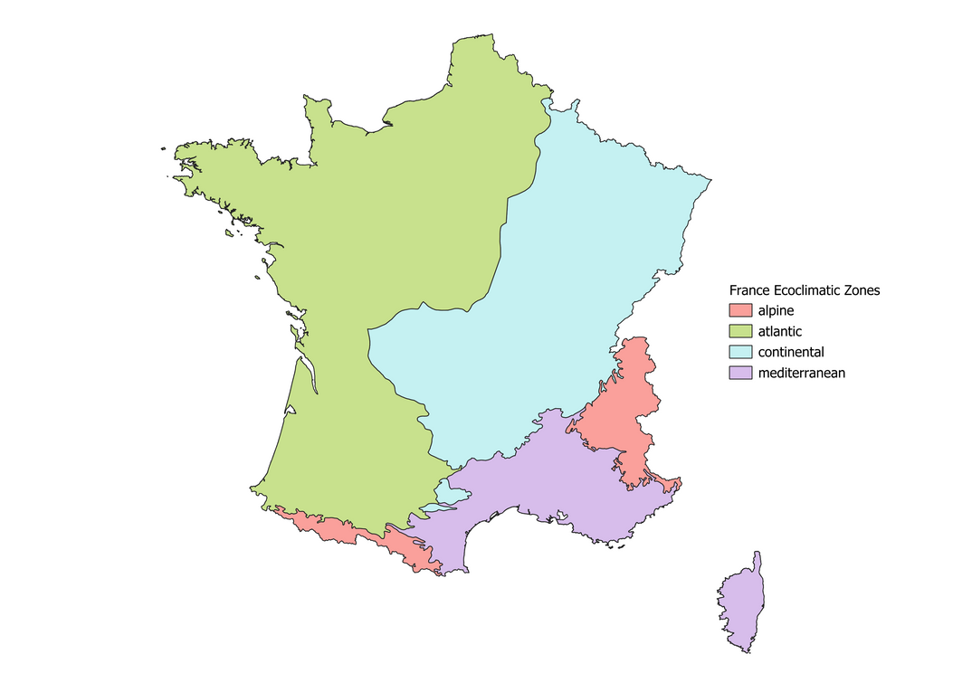
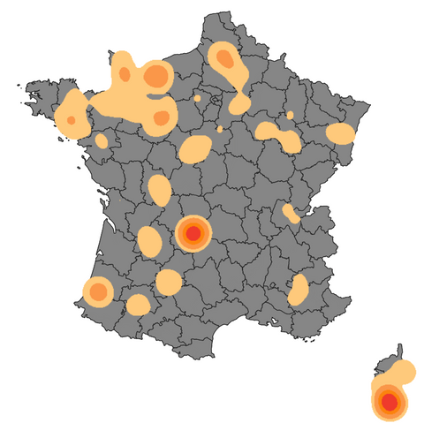
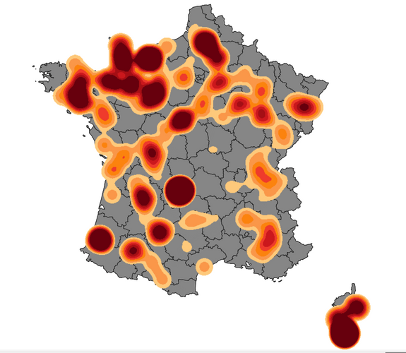



1. IDENTIFYING ENVIRONMENTAL DETERMINANTS
2 OBJECTIVES:
2. PREDICTION UNDER CLIMATE CHANGE
determinants for presence =/= determinants for abundance
Using future projection data from:
IPCC* SCENARIOS:
Most Optimistic (1.5°C by 2050)
Next Best (1.8°C by 2100) ...
Presence/absence
model variables
Abundance
model variables
1.5°C by 2050
3.6°C by 2100
explainable ML
Explaining
global predictions
Explaining
local predictions
Presence/absence + abundance prediction
*IPCC = Intergovernmental Panel For Climate Change

